Slide 1
UNIT TWO – Part One

Slide 2
Information Technology and the Changing Business
Secure an online identity
Establish a web presence
Enable e‐commerce
Provide e‐commerce and customer relationship management
Use a service application model

Slide 3
The five essential characteristics of useful information
Timeliness
Quality
Completeness
Relevance
Understandability

Slide 4
Decision Support System (DSS)
A decision support system (DSS) allows users to interact directly with a computer to organize and analyze data for solving complex and sometimes unstructured problems. Decision support systems are now available to help with such business decisions as mergers and acquisitions, plant expansions, new product developments and share portfolio management, among many others

Slide 5
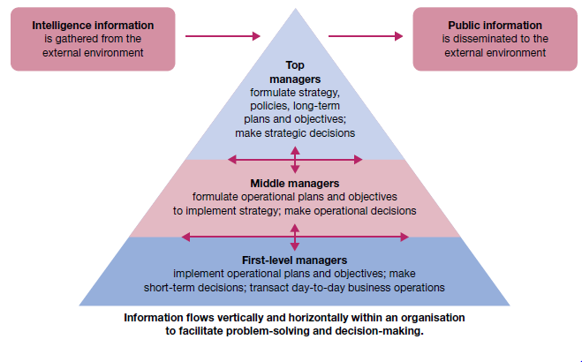

Slide 6
External and internal information needs of organizations
Organizations to have Intranets and Corporate Portals that allow employees, by password access, to share databases and communicate electronically
Extranets and Enterprise Portals that allow communication and data sharing between the organization and special elements in its external environment.
Electronic Data Interchange, or EDI. It uses controlled access to enterprise portals and supporting software to enable firms to transact business electronically with one another
Information and Decision Making , A decision, to be precise, is a choice between alternative courses of action. The process of decision‐making is driven in part by the quality of information available

Slide 7
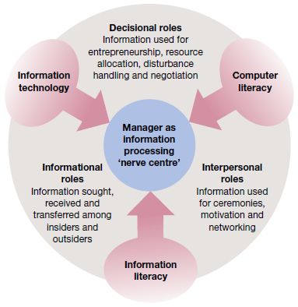
Information technology is breaking down barriers and changing organizations
Information technology is breaking down barriers and changing organizations

Slide 8
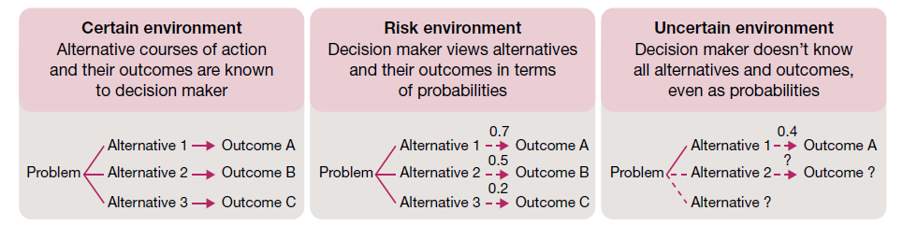
Decision conditions
Three conditions environments

Slide 9
Approaching Decisions
problem avoiders
Problem solvers
Problem seekers

Slide 10
Systematic Thinking
In systematic thinking a person approaches problems in a rational, step‐by‐step and analytical fashion. This type of thinking involves breaking a complex problem into smaller components and then tackling them in a logical and integrated fashion. Managers who are systematic can be expected to make a plan before taking action and then to search for information to facilitate problem solving in a step‐by‐step fashion

Slide 11
Intuitive Thinking
Intuitive Thinking, on the other hand, is more flexible and spontaneous and may also be quite creative. This type of thinking allows us to respond imaginatively to a problem based on a quick and broad evaluation of the situation and the possible alternative courses of action. Managers who are intuitive can be expected to deal with many aspects of a problem at once, jump quickly from one issue to another and consider ‘hunches’ based on experience or spontaneous ideas. This approach tends to work best in situations of high uncertainty where facts are limited and few decision precedents exist.

Slide 12
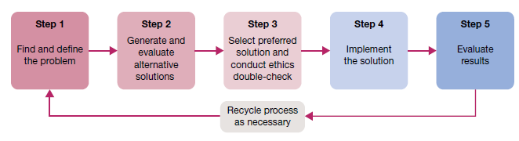
Decision Making Process

Slide 13
Decision making step 1
Identify And Define the Problem
The first step in decision making is to find and define the problem.
Mistake number 1 is defining the problem too broadly or too narrowly
Mistake number 2 is focusing on symptoms instead of causes. Symptoms are indicators that problems may exist, but they shouldn’t be mistaken for the problems themselves.
Mistake number 3 is choosing the wrong problem to deal with. Managers should set priorities and deal with the most important problems first. They should also give priority to problems that are truly solvable.

Slide 14
Decision making step 2
Generate and Evaluate Possible Solutions
A very basic evaluation involves cost–benefit analysis
Benefits. What are the ‘benefits’ of using the alternative to solve a performance deficiency or take advantage of an opportunity?
Costs. What are the ‘costs’ of implementing the alternative, including resource investments as well as potential negative side effects?
Timeliness. How fast will the benefits occur and a positive impact be achieved?
Acceptability. To what extent will the alternative be accepted and supported by those who must work with it?
Ethical soundness. How well does the alternative meet acceptable ethical criteria in the eyes of the various stakeholders?

Slide 15
Decision making step 3
Choose a Solution
Management theory recognises differences between the classical model and the behavioural model of decision-making
The classical decision model views the manager as acting in a certain world. Here, the manager faces a clearly defined problem and knows all possible action alternatives as well as their consequences
an optimising decision that gives the absolute best solution to the problem
approach is a very rational model that assumes perfect information is available for decision-making

Slide 16
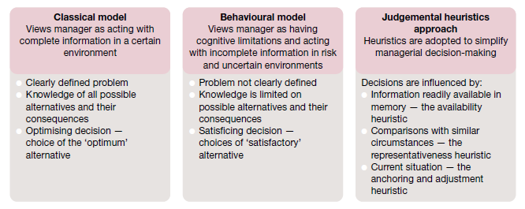

Slide 17
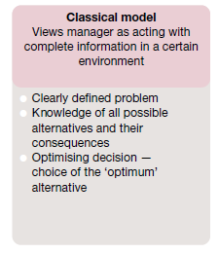
Classical Model

Slide 18
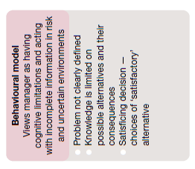
Behavioural Model

Slide 19
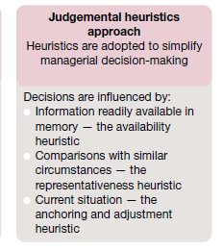
Judgemental Heuristics Approach

Slide 20
Decision making step 4
Implement the Solution
Given the choice of preferred solution, appropriate actions must be taken to fully implement it. This is the stage at which directions are finally set and problem‐solving actions are initiated
implementation typically follows quickly, smoothly and to everyone’s satisfaction. Involvement not only makes everyone better informed, it also builds the commitments needed for implementation.

Slide 21
Decision making step 5
Evaluate Results
The decision‐making process is not complete until results are evaluated
evaluation is a form of managerial control
It involves a continuing commitment to gather information on performance results
If the original solution appears inadequate, a return to earlier steps in problem‐solving may be required to generate a modified or new solution
problem‐solving becomes a dynamic and ongoing activity within the management process
Evaluation is also made easier if the solution involves clear objectives that include measurable targets and timetables.

